Slide 1
Pairs Trading: Implements and analysis
Weiyi Chen, Yao Class 00, Tsinghua Univ.

Slide 2
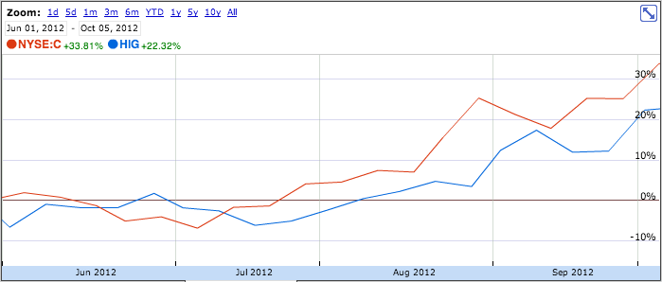
Principle
CHART - GOOGLE FINANCE
1. Find divergences of highly correlated pairs
2. Make money when they converge
24 Aug 2012
C, buy 58.24
HIG, sell 62.12
10 Sep 2012
C, sell 71.20
HIG, buy 58.12

Slide 3
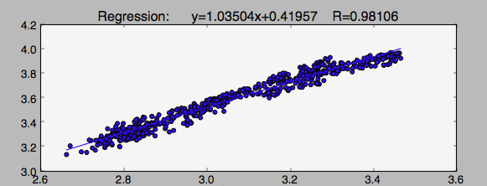
Part 1: Find pairs
EXAMPLE OF ___ & ___
1. Calculate correlation of returns
2. Find highly correlated pairs
3. Find best fit line and average and standard deviation of distances from line

Slide 4
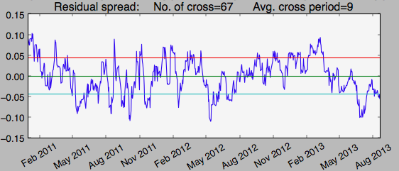
Part 2: Select Pairs
EXAMPLE OF ___ & ___
1. Generate residual spread (distance from best fit line)
2. Select pairs with more crossings and larger standard deviation

Slide 5
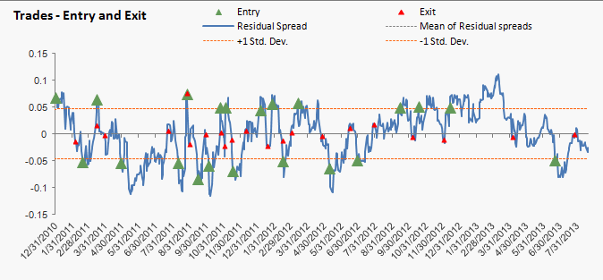
Part 3: Trade pairs
EXAMPLE OF ___ & ___
Entry: residual spread reaches ±1.0 std
Exit: residual spread crosses 0.0

Slide 6
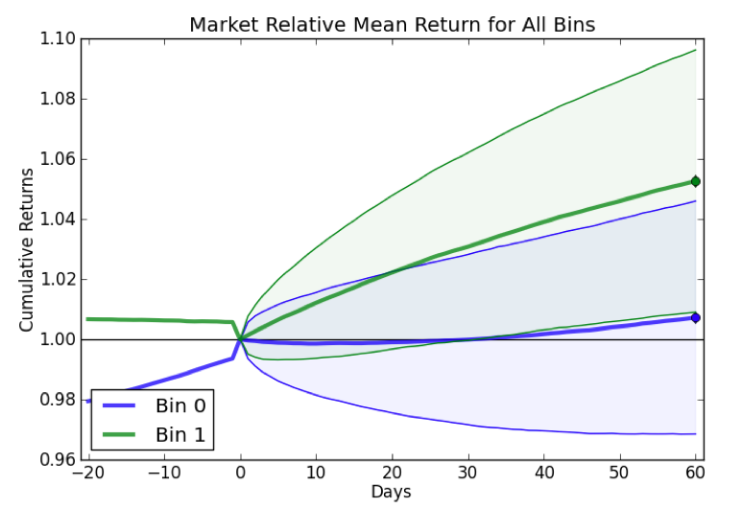
Result: Event study
Correlated Pairs Event Study Results

Slide 7
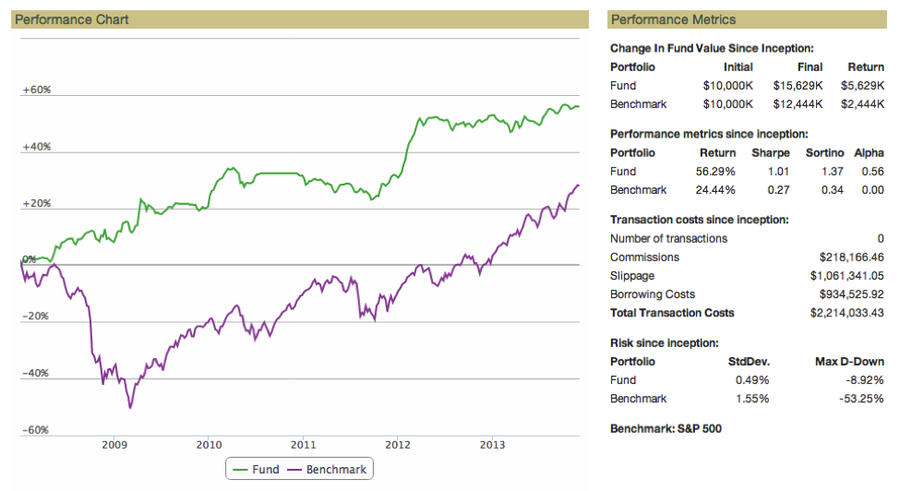
Result: Backtest
Correlated Pairs Backtest Results, Jan 08 – Jan14

Slide 8
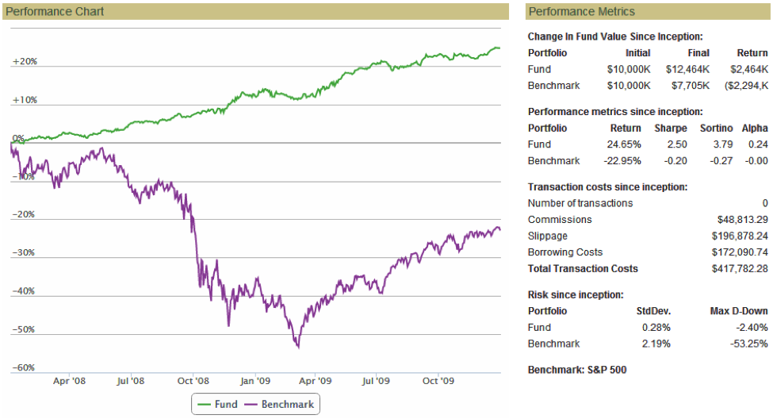
Result: Backtest
Correlated Pairs Backtest Results, Jan 08 – Jan 10

Slide 9
What I did - 1
Theory (Mathematics / Statistics)
Model introduction
Co-integration
Error correction
Model construction
Correlation, to define co-integration
Error correction, proof by time series analysis
Residual spread, orthogonal distance regression

Slide 10
What I did - 2
Implementation (Computer programming & Algorithm)
Write Python libraries to support analysis
Portfolio assessment
Event study
Market simulator
Financial indicators (ML features)
Machine Learning
KNN, Random Forest, SVM (Poly)
Financial indicators to select pairs

Slide 11
What I did - 3
Application (Financial strategy)
Modify original pairs trading strategy
Construct one able to make profit
Show how strategy lose value
Profit decrease after strategy publication (2004)
Abysmal return after Knight Capital invests large portion of the market (2010)

Slide 12
References
Pairs Trading: Quantitative Methods and Analysis Ganapathy Vidyamurthy, Wiley Finance, 2004
Engle R F, Granger CW. Co-integration and error correlation: representation, estimation, and testing. Econometrica: journal of the Ecnometric Society, 1987
Gatev E, Geotzmann W N, Rouwenhorst K G. Pairs trading: Performance of a relative-value arbitrage rule
Banerjee A, Dolado J J, Galbraith J W, et al. Co-integration, erroe correction and the ecnometric analysis of non-stationary data

